Slide 1
LEGEND INTERNET LIMITED
August 2023 Monthly Performance Review (V.1.0)

Slide 2
Document Review and Approval
Revision History
Version | Author | Date | Revision
1.0 | Joshua Odiniya | 24/5/2023
This document has been reviewed by
S/N | Reviewer | Date of Review
1 | Aisha Abdulaziz
2
3
This document has been approved by
S/N | Name | Signature | Date
1 | Aisha Abdulaziz

Slide 3
Table of Content
Business Performance
Business Performance: Business Performance Overview 4
Finance 5
Working Capital Management Analysis 6 New Sales Breakdown 8
Budget Analysis 11
Revenue 12
Profit & Loss 14
Operations 15
Sales 16
Legend Pay 25
Legend WiFi 42
Service Delivery 47
Database Management
Customer Care 56
Marketing 67
HR and Appraisal 80

Slide 4
OVERVIEW
This month we observed a 5% improvement in our operating ratio when compared to the previous month. However, we were not able to achieve our Sales target for the month due to a lack of drive and compliance to our SOP. Similarly, our activation target was not achieved as we did not utilize our resources at hand optimally in line with our operational strategy for the year.
There has been a clear inability of the Legend Team to successfully implement its Strategy as planned in the beginning of the year and reviewed monthly. The major challenge of getting the operational model right has affected every plan made by the company.
Our past studies have shown that a stronger dependence on Technology and Automation will reduce the dependence on human and manual efforts that are not adequate or suited to handle the rapid advancements in consumer behavior and expectations.
To respond to this we have developed and launched the My Legend app and will devote our focus towards ensuring administration functions seamlessly and the fulfilment matches in line with our SOPs.

Slide 5
FINANCE

Slide 6
Ratio Analysis
Target 63.82%

Slide 7
Ratio Analysis (Contd)
Target 3.14%

Slide 8
New Sales

Slide 9
New Sales Per Product

Slide 10
Revised Budget Sales Revenue Target
 | REVENUE TARGET | ACTUAL REVENUE | PERCENTAGE
LEGEND
Fiber Subscription | 5,930,000 | 1,959,625 | 33.05%
WiFi | 2,550,000 | 360,000 | 14.12%
Pay | 3,100,000 | 648,540 | 20.92%
Fiber Installation | 5,019,250.00 | 4,732,125 | 94.28%
Other Income | 1,250,000 | 904,500 | 72.36%
Total | 17,849,250 | 8,604,790 | 48.21%

Slide 11
Budget Performance

Slide 12
Revenue Growth

Slide 13
Revenue Performance - YTD
 | ACTUAL | BUDGET | PERCENTAGE
LEGEND | 827,216,476 | 1,184,401,747.57 | 70%

Slide 14
Profit And Loss Account For the Period - Legend
 | Jul-23 | Aug-23
TURNOVER | 103,898,295 | 102,434,753
COST OF SALES | 47,598,156 | 49,039,643
GROSS PROFIT | 56,300,139 | 53,395,110
LESS OPERATING EXPENSES | 17,001,302.05 | 18,657,230.05
DEPRECIATION | 12,540,660.38 | 12,540,660.38
INTEREST | 958,904.11 | 767,123.29
TOTAL EXPENDITURE | 78,099,022.54 | 81,004,656.72
PROFIT BEFORE TAX | 25,799,272.46 | 21,430,096.28
GROSS PROFIT MARGIN | 54.19% | 52.13%
NET PROFIT MARGIN | 24.83% | 20.92%

Slide 15
OPERATIONS

Slide 16
Sales

Slide 17
Channel Performance Achievement

Slide 18
Digital (Get Legend)

Slide 19
Channel Conversion
 | LEADS TARGET | LEADS | FTTB | NO COVERAGE | VIABLE LEADS | CONVERTED | Conversion Rate
Digital | 35 | 125 | 0 | 56 | 66 | 6 | 9%
Call center | 88 | 3 | 0 | 0 | 3 | 0 | 0%
LEGEND Lounge | 40 | 12 | 0 | 0 | 20 | 11 | 65%
Legend Zone | 0 | 0 | 0 | 0 | 0 | 0 | 0%
Installer Program | 69 | 3 | 0 | 0 | 3 | 6 | 100%
Direct | 90 | 9 | 0 | 0 | 9 | 9 | 100%
MDU | 484 | 13 | 0 | 0 | 13 | 13 | 100%
May Total | 806 | 169 | 3 | 56 | 110 | 42 | 38.18%
April Total | 267 | 155 | 0 | 39 | 115 | 51 | 44.35%
March Total | 480 | 200 | 0 | 39 | 160 | 91 | 56.88%
February Total | 892 | 394 | 0 | 78 | 314 | 179 | 57.01%
January Total | 1758 | 768 | 0 | 156 | 608 | 340 | 55.92%

Slide 20
Digital Leads Summary
Table 1
S/N | STATUS | SUMMARY
1 | Awaiting Payment | 1
2 | Not Intrested | 0
3 | Needs more Follow ups | 5
4 | Not Reachable | 0
5 | Already a Customer | 0
6 | Conversion | 7

Slide 21

Analysis:
This month the Digital channel brought in 79 leads, out of which 7 had No Coverage leaving us with 72 viable leads and 19 were converted (26% Conversion rate).
The Call Center channel brought in 49 leads out of which we had 2 had no coverage, leaving us with 47 viable leads and 14 leads were converted (29%).
This month, we had 22 walk in customer, 0 No Coverage, 0 FTTB, out of which 18 customers made their payment (81%), while in July we had 12 walk-in customers and all 11 converted.
We had 13 Direct leads from the Staff out of which 11 have been converted - 85% conversion rate from this channel, while in July we had 7 leads and 7 converted.
We also had 6 Leads from Installer Program and 6 all Converted- 100%, while in July we had 2 leads and 2 converted.
We also had 5 Leads from MDU and 4 all Converted- 80%, while in July we had 8 leads and 8 converted.
In summary we had 165 viable leads in total, with 72 of them converted thereby achieving 44% conversion rate from the channels this month.

Slide 22
MDU Database
June, 2023.
Total
Achieved
%
MDU in Database
1,670
1,202
72%
Units in Installed MDUs
23,073(8,667– occupied)
5,007
56%
Sales Target
MDU Engaged

Slide 23
Table 1
Content Marketing Competitive Analysis
Social Media Followers | Facebook | Instagram | Twitter | YouTube | LinkedIn | Total Following
Legend Fiber | 0 | 2,700 | 2,300 | 334 | 336 | 5,670
BCN | 0 | 128 | 0 | 0 | 0 | 128
Cyberspace Network Limited | 596 | 2,400 | 81 | 43 | 2,000 | 5,120
Dotmac Fiber | 4,100 | 3,800 | 768 | 0 | 883 | 9,551
Fiber-one | 1,300 | 8,400 | 1,500 | 603 | 5,000 | 16,803
Galaxy Backbone | 8,900 | 1,800 | 8,900 | 3,004 | 7,000 | 29,607
IPNX | 8,200 | 3,600 | 5,500 | 145 | 19,000 | 36,445
Layer3 Limited | 5,900 | 1,300 | 7 | 15 | 13,000 | 20,222
Main One | 10,000 | 2,000 | 6,100 | 498 | 0 | 18,598
Partner Mobile Fiber | 148,000 | 17,500 | 10,001 | 0 | 0 | 175,501
Phase3 Fiber | 6,900 | 622 | 0 | 13 | 7,361 | 14,896
Skypro Internet | 22 | 637 | 7 | 0 | 0 | 666
Spectranet Air Fiber | 5,014 | 8 | 26,900 | 957 | 0 | 32,879

Slide 24
Churn Customers willing to come back
Table 1
S/N | NAME | OLT | SPLITTER | STATUS
1 | Ritchie Etonye | GWARINPA | Mabglobal 4 Splitter | churn
2 | Aisha Okuboye | GWARINPA | BH LIFECAMP IKOYI SPLITTER 1 | churn
3 | Abdulmutallib Shehu Shagari | ASOKORO | Durumi Splitter 2 | churn
4 | Abdullahi M. A | GWARINPA | Mabglobal 4 Splitter | churn
5 | Fauziya Shehu Fari | GWARINPA | BH Kingsway Splitter | churn
6 | Embassy of the State of Palestine Residence | ASOKORO | QUANTEQ | churn
7 | Mr. Siraj Ibrahim Tanko | GWARINPA | Bilaad Splitter | churn
8 | Vishal Pathak | HQ | EUPHRATES / REGENT | churn
9 | Chidi Samuel Chidebe | ASOKORO | Jose Marti Splitter | churn
10 | Femi Atewogbade | WUYE | Al-Gamji 2 Splitter | churn
11 | Abdullahi Ahmed | HQ | LAKE VIEW HOME PHASE 1 (ELIJAH) | churn
12 | Dr. Maryam Yusuf | GWARINPA | Lakeview Homes Phase 1 Splitter | churn
13 | Hajiya Aisha | GWARINPA | BH City Lifecamp Splitter 3 | churn
14 | Chadi Saraf | HQ | Peka Close Splitter | churn
15 | Busola Abayomi | GWARINPA | Godab Estate Splitter | churn
16 | Ahmadu Adamu Muazu | ASOKORO | DG NIA | churn
17 | Dr Lan | GWARINPA | BH GLOVER STR SPLITTER 1 | churn
18 | Hon Moses O. Anaughe | ASOKORO | SD DAN IYA Splitter | churn
19 | Abba Zanna HAMZA | GWARINPA | GAMES VILLAGE SPLITTER | churn
20 | Maryam Y Ibrahim | HQ | Salt Lake Splitter | churn

Slide 25
Churn Customers willing to come back
Table 1
21 | Chris Jemitola | ASOKORO | Udi Hills Splitter | churn
22 | Babalola Olanrewaju | GWARINPA | Paradise Estate 1 | churn
23 | Chiagozie Hillary Nwokoko | GWARINPA | KATAMPE EXTENSION | churn
24 | Abdulmumin Oniyangi (Tetfund) | GWARINPA | Mab Global Splitter | churn
25 | Maryam Y Ibrahim | HQ | lSalt Lake Splitter | churn
26 | Idiatu Lasisi | GWARINPA | BH City Lifecamp Splitter 3 | churn
27 | Umar Yakubu | GWARINPA | KATAMPE/URBAN SHELTER | churn
28 | Mohammed Bello (Asokoro) | GWARINPA | GWARINPA | churn
29 | Maureen Okogwu | HQ | Rima Splitter | churn
30 | Alhaji Bashir Yusuf Ibrahim | HQ | Lake Chad Splitter | churn
31 | Colonel Samson Agada | GWARINPA | Kado Splitter | churn
32 | Ibrahim Bako | GWARINPA | NAF Conference Splitter | churn
33 | Edward Adejo | GWARINPA | BH City Lifecamp Splitter 3 | churn
34 | Nasiru Sadiq | GWARINPA | LAKE VIEW HOME PHASE 1 (ELIJAH) | churn
35 | Abubakar Isa Yuguda (BUA) | GWARINPA | BUA Court | churn
36 | Sufyan Sa’ad | GWARINPA | NAF Conference Splitter | churn
37 | Isa Muhammad | GWARINPA | Kado Splitter | churn
38 | Musa Adamu | GWARINPA | URBAN SHELTER 2 | churn
39 | Princess Osifo | GWARINPA | Jahi Splitter 5 | churn
40 | Adedamisi Pegba-Otemolu | GWARINPA | URBAN SHELTER 2 | churn
41 | Rufai Dabo | GWARINPA | Kado Splitter | churn
42 | Kunle Adegun | GWARINPA |  | churn

Slide 26
MDU Classification
Estate Classification | Total No of Classification | Total No of Apartments | Occupied | Total Installed | Total Paid | Active | %. Penetration
Platinum | 88 | 4,208 | 2,315 | 1,591 | 1,515 | 865 | 65%
Gold | 822 | 17,111 | 5,757 | 2,887 | 3,101 | 987 | 54%
Silver | 285 | 1,788 | 538 | 261 | 324 | 187 | 60%
Total | 1,195 | 22,847 | 8,483 | 4,789 | 4,919 | 2,039 | 58%

Slide 27
LEGEND PAY

Slide 28
Summary
1. A comparison of the month of August saw us achieve a total of 468 transactions. We also witnessed a sales volume of NGN 648,550.
We also realized NGN 10,200 in bank withdrawal charges. We also had 11 Tv subscription transactions.
We also completed the cash token feature on the Legend Pay mobile app

Slide 29
Legend Pay three month transaction overview

Slide 30
Legend Pay transaction breakdown

Slide 31
August transactions at merchant locations

Slide 32
Comparison of Sales volume Achieved vs Targeted sales volume

Slide 33
Failed Transactions Comparison Between August and July

Slide 34
Users with Failed Transactions
S/N | Userid | Full name | Phone number
1 | 3299 | Khalifa Mohammed | 7015915096
2 | 9330 | Adam Wilson | 7081339468
3 | Emmasimeon3 | Emmanuel Simeon | 8058220157
4 | 6947 | Simon Esau | 9060332766
5 | 2376 | Ibrahim hassan | 9091733333
6 | 3034 | Harrow Park | 8031531991
7 | 1483 | Keiza Igbazua | 7064755316
8 | Zaheed | Adamu Hamisu | 7069703214
9 | 5898 | Ayodeji Fayomi | 8052745555
10 | 4483 | Bala mohammed | 8137779329

Slide 35
Breakdown on the cause of the failed transactions
15 Airtime transactions failed because the users put wrong/ incomplete numbers.
6 AEDC payment failed
313 Transactions failed because of low funds on VTpass as there were no funds there between the 17th to the 21nd of August 2023
25 out of 54 users who experienced failed transactions successfully tried purchasing again and were successful.
Total volume of failed transaction was 375,500

Slide 36
Failed transactions breakdown

Slide 37
Failed transactions breakdown

Slide 38
Failed Transactions breakdown

Slide 39
Key users.
The following customers purchased Airtime , Electricity and Paid at Merchant locations : Terfa Daniel (Terfa), Aisha Abdulaziz (7354).
35 non staff bought Airtime, 2 Patronized merchant locations, 5 non staff bought AEDC. Also 12 customer paid for TV subscriptions .
54 users experienced failed transactions.

Slide 40
Non-Staff transactions at Merchant locations
S/N | Merchant | Customer name | Amount | Date
1 | Hootas restaurant lounge and event centre | Islam Saleh | 11851 | 2023-08-17
2 | Hootas restaurant and lo | Adam Wilson | 11000 | 2023-08-13

Slide 41
Profit Comparison
 | August |  |  | July
Metric | Number of Users | Achieved volume | Profit made | Number of Users | Achieved volume | Profit made
Airtime | 87 | ₦272,950.00 | ₦9,221.00 | 70 | ₦40,650.00 | ₦1,099
AEDC | 7 | ₦491,400.00 | ₦6,331.00 | 2 | ₦82,000.00 | ₦1,056
Merchants(users) | 8 | ₦223,257.00 | ₦4,34700 | 7 | ₦104,432.00 | ₦2,810
Bank transfer charges | 40 |  | ₦20,000.0 |  | 28,700 | ₦20,940.00
Total volume | 102 | ₦1,116,428.00 | ₦39,889.00 | 111 | ₦1,134,812.00 | ₦86,214.00

Slide 42
August transactions

Slide 43
Merchant activities for the month of August
Merchant acquisitions: the following merchants were engaged and received proposals namely: Edible creations (Gwarinpa), Edible (creations Garki),K.O barbers, Butter Café,

Slide 44
LEGEND WIFI

Slide 47
LEGEND WI-FI ACTIVITIES
Legend Wi-Fi Deployments: The following deployments commenced this month: Baslico Restaurant, enjoy yourself Restaurant, the showroom, Vshop, lacoste store, afristar media, red dish (truck central)
Legend Guest Wi-Fi: 6 sale was closed this month: N755,000 (Baslico Restaurant, vshop, so garden, afristar media, truck central, cmec center)
Legend Free Wi-Fi: 2 Free Wi-Fi location were identified: Butter Restaurant and cafe and salt & pepper grill)
Legend Wi-Fi monitoring: 85% availability was achieved this month, this was due to the locations using Huaweii being offline as a result of the controller going offline. impacted the usage of the wifi service, although we recorded a total of 25 LOS this month with 6 resolved 6 diagnosed and 4 MTSS ongoing. We started the month with 25 LOSs, currently we have 29 on LOS. No positive change due to locations going down whilst a few being resolved.

Slide 48
LEGEND WIFI ANALYSIS
Legend Guest Wi-FI locations: 121 (96 active)
Legend Free Wi-Fi locations: 68 (40 active)
Legend Zone: 22 (18 active)
Total: 187 locations (148 active)
Locations on LOS: 28
Locations undergoing installations: 10

Slide 49
SERVICE DELIVERY

Slide 50
SUMMARY

Slide 51
Activations

Slide 52
Ongoing Jobs

Slide 53
MDU & STAND ALONE

Slide 54
Break Down of Ongoing Jobs

Slide 55
(155) NETWORK DEPENDENCIES

Slide 56
(513) Overdue Jobs Categorization

Slide 57
Installer’s compliance

Slide 58
(56)New Jobs Categorization

Slide 59
LOS Compliance Rate %

Slide 60
Breakdown of Jobs Categorizations.
 |  |  | New installation categorizations
 |  | Activated | LM Ongoing | LM Pending | PT | BB/Access Jobs | Splitter/Expansion | TSS | Awaiting CPE | Others | Total
New Jobs:
LM Green Areas: | 30 | 11 | 0 | 12 | 0 | 0 | 0 | 4 | 0 | 3 | 30
Access Green Areas: | 23 | 8 | 0 | 12 | 0 | 0 | 0 | 2 | 0 | 1 | 23
Correction/ Expansion Areas: | 7 | 2 | 0 | 2 | 0 | 1 | 0 | 1 | 0 | 1 | 7
Access Corrections | 21 | 7 | 0 | 12 | 1 | 0 | 0 | 1 | 0 | 0 | 21
 |  |  | Overdue installation categorizations
 |  | Activated | LM Ongoing | LM Pending | PT | BB/Access Jobs | Splitter/Expansion | TSS | Awaiting CPE | Others | Total
LM Green Areas: | 86 | 7 | 22 | 41 | 4 | 0 | 0 | 2 | 2 | 8 | 86
Access Green Areas: | 205 | 16 | 44 | 95 | 6 | 17 | 0 | 3 | 1 | 23 | 205
Correction/ Expansion Areas: | 37 | 2 | 4 | 7 | 0 | 13 | 0 | 0 | 0 | 11 | 37
Access Corrections | 95 | 10 | 8 | 20 | 5 | 36 | 0 | 1 | 1 | 14 | 95

Slide 61
AVERAGE DAYS

Slide 62
DATABASE MANAGEMENT

Slide 63
Customer Metrics -Overview
76
64
33
76
Jobs Orders
64 Activated Customers
33 Provisioned Customers
Dual Play 62
Triple Play X 1
Relocation 4
Triple Play 8
Guest WIFI 1
Dual Play 51
Triple Play X 1
Triple Play 9
Relocation 2
Guest WIFI (Users) 1
New Customers Activated 23
Dual Play 25
Triple Play 5
Triple Play X 1
Relocation 1
Guest WIFI (Users) 1
Pre-provisioned Connections 26
Your Logo Here

Slide 64
Job Order & Variance Report
 | APRIL | MAY | JUNE | JULY | AUGUST | VARIANCE | % GROWTH/DEGROWTH
Dual Play | 35 | 40 | 60 | 38 | 62 | 24 | 63%
Triple Play | 3 | 8 | 10 | 7 | 8 | 1 | 14%
Triple Play x | 2 | 0 | 4 | 3 | 1 | -2 | -67%
Legend Internet | 1 | 0 | 1 | 0 | 0 | 0 | 0
Guest Wi-Fi | 3 | 0 | 0 | 3 | 1 | -2 | -67%
Relocation | 2 | 3 | 0 | 3 | 1 | 1 | 33%

Slide 65
MOM Activations By Product Comparison
 | May | June | July | August | VARIANCE | % Growth/Degrowth
Dual Play | 22 | 19 | 33 | 51 | 18 | 55%
Triple Play | 11 | 7 | 4 | 9 | 5 | 125%
Triple Play X | 1 | 0 | 2 | 1 | -1 | -50%
Legend Internet | 1 | 0 | 1 | 0 | -1 | -100%
Guest Wi-Fi | 0 | 1 | 2 | 1 | -1 | -50%

Slide 66
Customer Daily Distribution Metrics

Slide 67
MOM Customer Metrics Comparison
 | May | June | July | August | VARIANCE | % Growth/Degrowth
New Customer | 54 | 78 | 54 | 76 | 22 | 41
Activations | 37 | 32 | 42 | 64 | 22 | 52
Provisioned | 25 | 42 | 30 | 33 | 3 | 10

Slide 68
Monthly Customer Status Ratio
Dual Play 1865
Legend Internet 333
Triple Play 602
Triple Play X 57
Dual Play 2172
Legend Internet 213
Triple Play 617
Triple Play X 57
41%
44%
Dual Play 706
Legend Internet 82
Triple Play 184
Triple Play X 18
14%
Your Logo Here
Your Logo Here

Slide 69
MOM Customer Status Product Performance
June
July
August

Slide 70
Overall Customer Status Variance Report
 | April | May | June | July | August | VARIANCE | %Growth / Degrowth
Active | 3097 | 3138 | 3072 | 3123 | 3067 | -56 | -2%
Inactive | 1283 | 1164 | 1064 | 991 | 990 | -1 | -0.1%
Churned | 2451 | 2518 | 2614 | 2704 | 2857 | 153 | 6%
Churned During Month | 160 | 168 | 209 | 213 | 165 | -48 | -23%
Ongoing Installations | 468
Total Customer Count | 6831 | 6820 | 6907 | 7027 | 7084 | 57 | 1%
% Active Customers With Churned | 45% | 46% | 44% | 44% | 43% | -1 | -2%
% Active Customers Without Churned | 71% | 73% | 80% | 72% | 73% | 1 | 1%

Slide 71
Payment Pattern & Channels

Slide 72
Monthly Faults Analysis
Your Logo Here

Slide 73
LOS Analysis
-
-
24,829,333.33
-
19,302,933.33
Your Logo Here

Slide 74
Monthly Faults Analysis
13
Your Logo Here
Your Logo Here

Slide 75
LOS Analysis
LOS Analysis
14
Your Logo Here
Your Logo Here

Slide 76
Customer Feedback Mechanism
Customer Feedback Mechanism

Slide 77
Customer Feedback Mechanism
Customer said everything has been going well except that every evening around 8 it goes down
Customer complained about intermittent connectivity occasionally
Customer confirmed connection is working perfectly fine and she is enjoying it

Slide 78
CUSTOMER CARE

Slide 79
INBOUND COMMUNICATION
TOTAL INBOUND
TOTAL RESPONDED
% RESPONDED
TOTAL RESOLVED
RESOLVED
5,862
6
5,841
97%
3,902
67%
TOTAL EMAILS
TOTAL LIVE CHAT
TOTAL CALLS
TOTAL LOUNGE VISITS
10,000
1,551
229
3,602
480
FAULTS
FAULTS
FAULT
10,000
FAULTS
1,271
179
3,245
230
ESCALATION
25
ENQUIRIES
ENQUIRIES
10,000
ENQUIRIES
128
30
ENQURIES
100
960
INSTALLATIONS
INSTALLATIONS
INSTALLATIONS
10,000
INSTALLATIONS
2
20
261
152
150

Slide 80
COMMUNICATION
Critical Faults 105
Communication: 380
- 1st String : 105
2nd String : 210
3rd String : 114
4th String : 74
Resolution :86
43%
Booking & Scheduling: 467
Communication: 934
100%
Major Faults: 303
Communication: 1,160
- 1st String : 206
2nd String : 412
3rd String : 318
4th String : 224
Resolution :150
FAULT
31%
INSTALLATION
Overdue Installation: 68
Communication: 136
54%
100%
Minor Faults: 138
Communication: 1,215
- 1st String : 210
2nd String : 420
3rd String : 285
4th String : 300
Resolution : 135
Post Installation: 65
Communication: 130
49%

Slide 81
Installation and Fault Communication
Category
Count
Category
Count
INSTALLATIONS | Comm to registered customers / Registered customers | 100/100
 | Registered customers raised on CMP/Total reg. customers | 100/100
 | Comm on issue events/total issue events | 68/68
 | Delayed instl msg/Total delayed installations | 136/68
 | Activation protocol/Total activations | 65/65
 | Post instl comm/total for the week | 98/39
 | No of communication/ No of Missed and late appointments | 300/150
 | Customer Registration/Number of communication | 80/80
 | No of Bookings/No of communication | 467/934
 | No of installations/No of communication | 150/300
 | Provisioning schedule/ No of commucations | 47/47
F​AULT | Number of customers communicated to/number of faults | 1092/546
 | major fault comm/total major faults | 1059/353
 | Critical fault communication/total critical faults | 315/105
 | Diagnosis with ETR communication/Total diagnosed faults | 870/584
 | 1st msg on faults/total faults | 1092/546
 | 2nd msg(diag +ETR/ total faults | 870/546
 | 3rd msg(delayed diag/total fauls | 354/546
 | 4th msg(extended ETR)/total faults | 310/546
 | Resolution msg/total msges | 1500/268
% Variance

Slide 82
Channel Communication
Channel | Category | Count
Lounge Complaints | No. of Customers attended to/Total Number of Customer who visited Lounge for complaints | 480/480
Ticket Performance Hubspot | Total Tickets | 1551
 | No of Active tickets | 340
 | No of Resolved tickets | 1211
 | First response time | 1.7 (hrs)
Live Chat Performance | Total Live Chats | 229
 | No of Open Live Chats | 208
 | No of Closed Live Chats | 208
 | First response time | 0.003
Calls | Returned Calls/Dropped Calls (Tech Support) | 295/948
 | Returned Calls/Dropped Calls (Call Center) | 554/948
 | No of customers who called in once | 760
 | No of customers who called in twice | 282
 | No of Customers who called thrice | 161
 | No of customers who called more than thrice | 135
 | No of calls answered satisfactorily/no of calls listened to | 1233/1300
% Variance

Slide 83
Post Installation and Happy Customer Surveys
Category | Segment | Count
Total number of call made | No of customers reached/total number of customers | 52/65
 | Number of no respons/total number of customers called | 37/65
Happy Customers | Number of customers happy/total number of customers called | 51/65
 | Total number of unhappy customers/total number of call made | 10/65
% Variance

Slide 84
Fault Breakdown
Category
July
August
%Variance
TOTAL TICKETS | 1,620 | 1,897 | -32.15
OPEN TICKETS | 666 | 1,840 | -31.02
CLOSED TICKETS | 596 | 1,371 | -33.09
VOICE ISSUES | 0 | 0 | 0.00
CONNECTIVITY INFRASTRATURE | 491 | 906 | -27.46
CONNECTIVITY INTERNET/APPLICATION | 4 | 13 | 25.81
CONNECTIVITY WIFI | 1 | 11 | -56.45
PREVENTIVE MAINTENANCE | 144 | 202 | -52.51
BANK TRANSFER PAYMENT | 1 | 2 | -65.22
LEGEND PAY | 4 | 2 | 34.62
PAYMENT ENQUIRIES | 4 | 3 | -66.67
INSTALLATION | 168 | 151 | -18.37
CUSTOMER REQUEST | 54 | 82 | -25.25
% Variance

Slide 85
Fault Breakdown (NEW TICKETS)
Fault Type
Fault Details
July
August
%Variance
T​elephony | Unable to make calls | 0 | 0 | 0.00%
 | Phone Configuration | 0 | 0 | 0.00%
Connectivity Infrastructure | LOS | 102 | 60 | 0.25%
 | Intermittent Connectivity | 0 | 0 | 1.00%
Connectivity Internet/Application | Buffering | 0 | 0 | -1.00%
 | Slow Browsing | 1 | 1 | 1.00%
 | Low Speed test | 15 | 0 | 5.50%
 | Intermittent Connectivity | 1 | 0 | -0.25%
 | Web Page not opening | 1 | 0 | -0.08%
 | High Latency | 0 | 0 | 0.00%
Connectivity WiFi | AP Damage/Faulty | 0 | 0 | -0.38%
 | Power/POE Damage/Faulty/Disconnection | 0 | 1 | -0.47%
 | Firmware/License Expiration/Erase | 0 | 0 | -0.68%
Bank Transfer Payment | Payment not reflecting | 1 | 0 | -0.65%
Legend Pay | Request for Login details | 1 | 0 | 0.00%
 | Wrong Payment into user account | 0 | 0 | 0.00%
 | Payment Not Reflecting | 0 | 0 | 0.31%

Slide 86
Fault Breakdown (NEW TICKETS)
Fault Type
Fault Details
July
August
October
%Variance
Payment Enquiries | Request for Subscription details | 0 | 0 | 0.00%
 | Request for hold on subscription | 0 | 0 | 0.00%
 | Request for Invoice | 0 | 0 | -100.00%
Installation | Installation Booking | 1 | 1 | 60.00%
 | Installation Delay | 10 | 5 | -23.53%
 | Installation Update | 2 | 0 | -40.00%
Customer Request | Change of Name/email/mobile | 0 | 0 | -22.22%
 | Compensation | 10 | 11 | -26.09%
Preventive Maintenance | High Attenuation | 10 | 5 | 89.66%
 | Planned Maintenance | 2 | 0 | 100.00%
 | Emergency Maintenance | 40 | 18 | -69.10%

Slide 87
MARKETING

Slide 88
May 2023 Summary
In May, we continued the Legend WiFi campaign in line with our quest to run a closed ecosystem.
The aim was to continue telling the story of how Legend is providing essential digital services on the best terms and to showcase the value created by democratizing internet and making it available to all and sundry.
The key that gives access to this Ecosystem has been set as Legend Pay. This is due to its strategic, ubiquitous and enabling capability as a product and also our Marketing Strategy focus which is to grow Legend Pay.

Slide 89
DIGITAL INSIGHTS

Slide 90
DIGITAL INSIGHTS
DIGITAL INSIGHTS
Instagram Analytics |  |  |  |  |  | Web Page Analytics
 |  | August |  |  |  |  |  | August
Impressions |  | 215 |  |  |  | Users
Profile Visits |  | 185 |  |  |  | New Users
Website Taps |  | 23 |  |  |  | Sessions
Likes |  | 14 |  |  |  | Page Views
Reach |  | 475 |  |  |  | Bounce Rate
Followers |  | -2
Facebook Analytics |  |  |  |  |  | Twitter Analytics
 |  | August |  |  |  |  |  | August
Engagment |  | 27 |  |  |  | Impressions |  | 1,885
Page Reach |  | 230 |  |  |  | Profile Visits |  | 232
Page Visits |  | 53 |  |  |  | Likes |  | 2
Likes |  | 3 |  |  |  | Mentions |  | 20
Unfollowers |  | -2 |  |  |  | Unfollowers |  | 3

Slide 91
PRODUCT PERFORMANCE

Slide 92
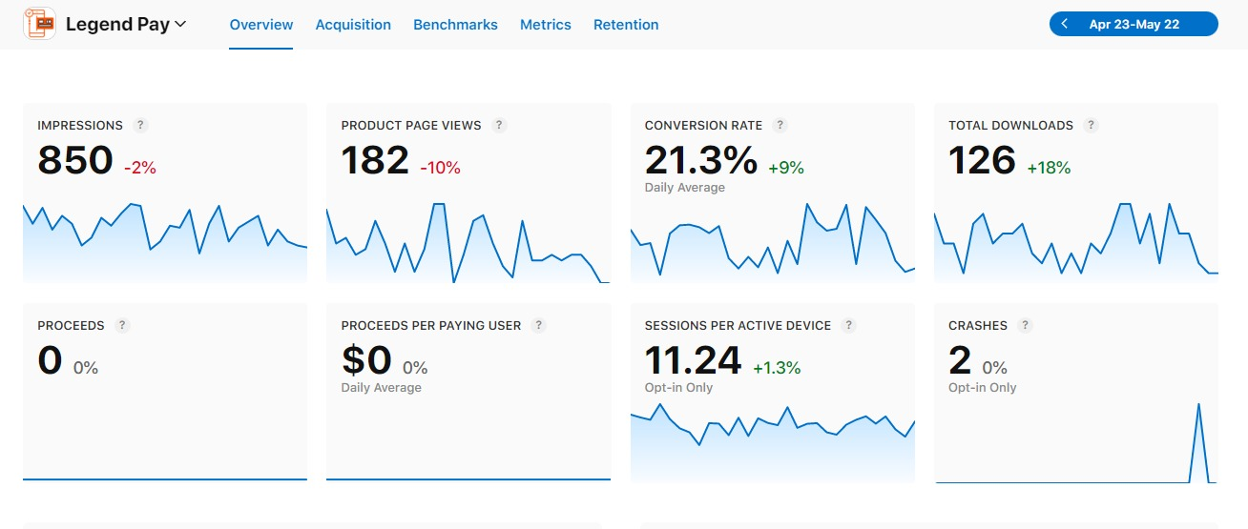
Legend Pay IOS Overview

Slide 93
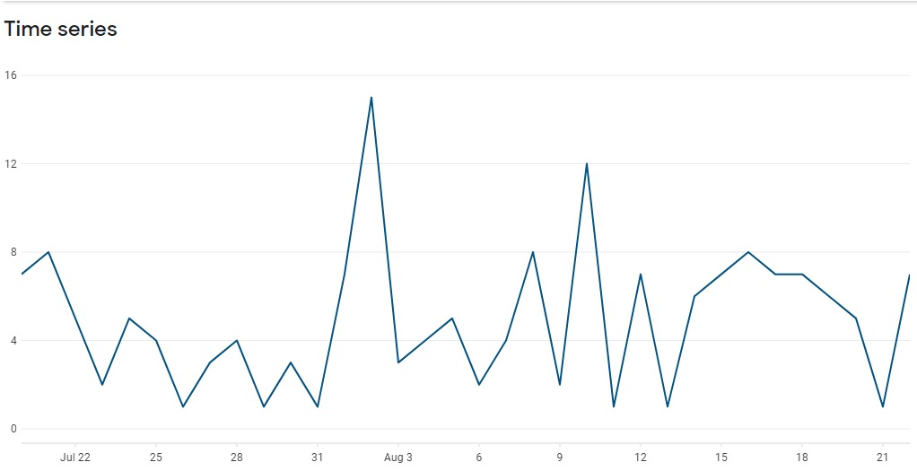
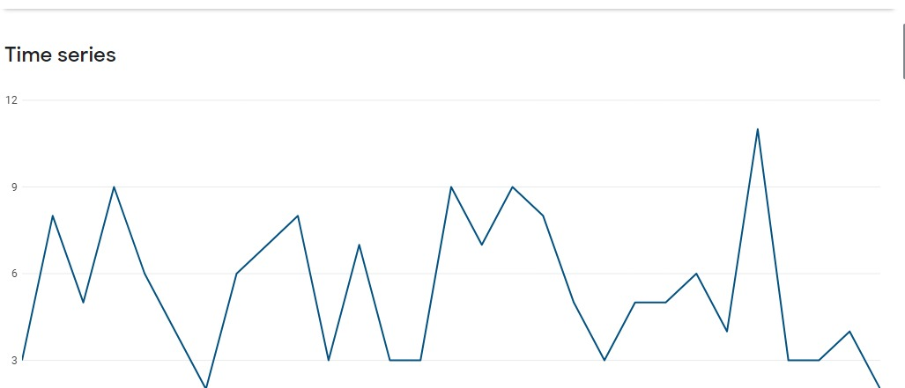
Legend Pay Android Downloads: 160

Slide 94
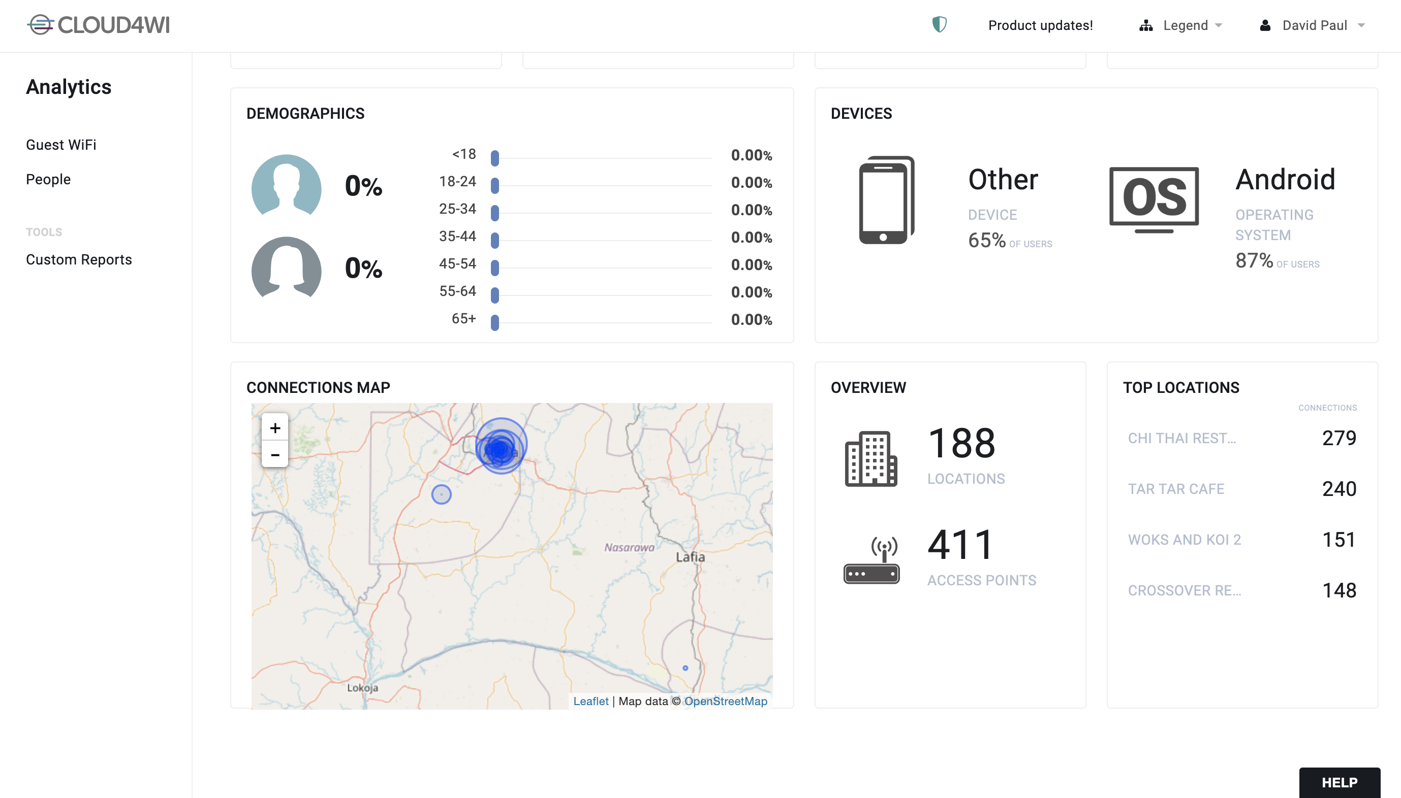
Legend WiFi

Slide 95
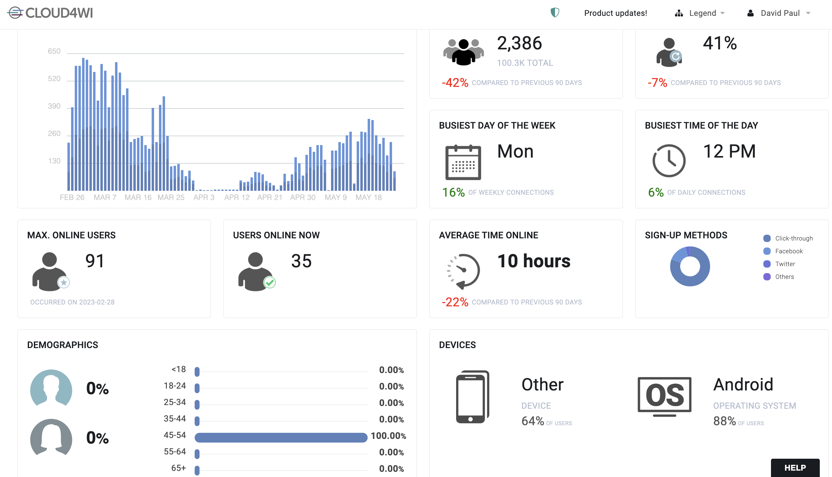
Legend WiFi

Slide 96
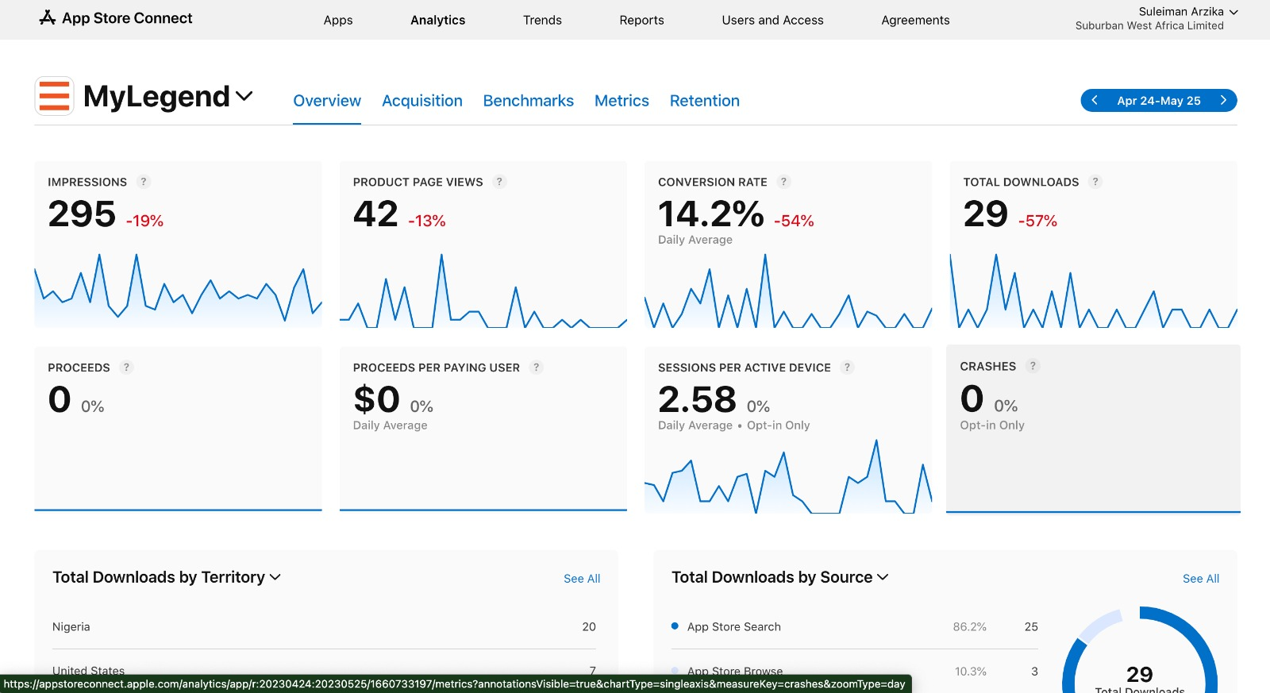
MyLegend - iOS

Slide 97
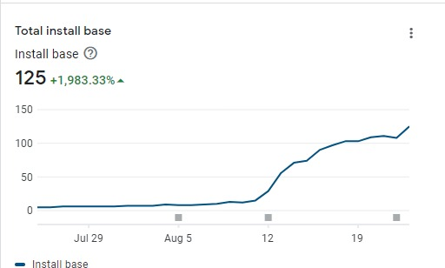
MyLegend - Android
Downloads: 125

Slide 98
Legend Fiber
 | LEADS TARGET | LEADS | FTTB | NO COVERAGE | VIABLE LEADS | SALES TARGET | CONVERTED | Conversion Rate
Digital | 54 | 125 | 3 | 56 | 66 | 20 | 6 | 9%
Call center | 68 | 3 | 0 | 0 | 3 | 25 | 0 | 0%
LEGEND Lounge | 26 | 12 | 0 | 0 | 20 | 15 | 11 | 92%
Legend Zone | 0 | 0 | 0 | 0 | 0 | 0 | 0 | 0%
Installer Program | 22 | 3 | 0 | 0 | 3 | 20 | 3 | 100%
Direct | 22 | 9 | 0 | 0 | 9 | 20 | 9 | 100%
MDU | 75 | 13 | 0 | 0 | 13 | 30 | 13 | 100%
Total | 267 | 155 | 0 | 39 | 115 | 130 | 42 | 38.18%

Slide 99
GET.LEGEND.NG
GET.LEGEND.NG
Below is the total number of leads and sales this month from GET LEGEND .
56
6
6
Customers
Activated
Total leads
Sales converted
REVENUE GENERATED
867,125.

Slide 100
CAMPAIGNS

Slide 101
LEGEND WIFI/LEGEND PAY CAMPAIGNS
In line with our strategy for the month, we continued the Legend Free Wifi Campaign to increase awareness and indirectly increase the adoption of the Legend Pay App as the only means to access free WiFi. The objective of the campaign is to create awareness and adoption for the Legend Pay App; increase number of transacting customers; increase number of Merchants/Agent location; and increase the revenue base of Legend Pay via the promotion of free Wifi.

Slide 102
COMMUNICATION CAMPAIGN
Customer Communication
Major fault messaging automation
Marketing Communication
Legend WiFi Campaign
Essential Digital Services
Legend Pay Campaign
Legend Brand Promise
4
1
Total email sends
Social media posts
Push notifications
1
47%
Email Open rate
Social media responses
negative/positive
21/1

Slide 103
May 2023 Summary
In May, we continued the Legend WiFi campaign in line with our quest to run a closed ecosystem.
The aim was to continue telling the story of how Legend is providing essential digital services on the best terms and to showcase the value created by democratizing internet and making it available to all and sundry.
The key that gives access to this Ecosystem has been set as Legend Pay. This is due to its strategic, ubiquitous and enabling capability as a product and also our Marketing Strategy focus which is to grow Legend Pay.

Slide 104
HUMAN RESOURCES

Slide 106
Departmental Rating

Slide 107
Departmental Rating
OPERATIONS

Slide 108
Departmental Rating
MARKETING

Slide 109
Departmental Rating
Finance

Slide 110
Departmental Rating

Slide 112
Thank you

